Slide 1

W209 Final Project Presentation
Football Fantasy League Helper
Michelle Liu, David Jablonski, Shane Conner
Notes:
Shane
Our project is on Fantasy Football which is where participants manage a roster of virtual roster of NFL to compete in head-to-head weekly matchups within a league of 8-12 members. Each team’s scores points based on the actual weekly performance of their selected starting players.

Slide 2
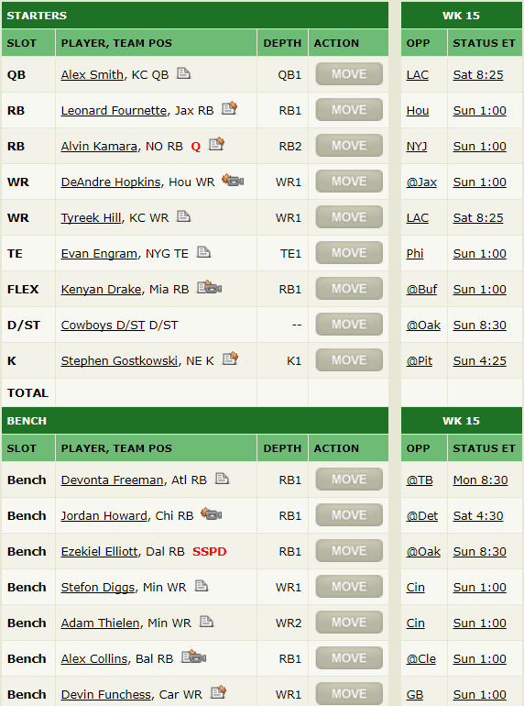
Tasks
Select players to start each week.
Easily search, filter and compare players.
Aggregate analyst’s projected points and rankings.
Ascertain player risk.
Evaluate player value across positions.
Calculate value over replacement
Assess trends and variation within positions.
Notes:
Shane
Fantasy Football has grown an incredible amount since its beginnings and because of this there is an incredibly large amount of expert and analyst information available. However, this isn’t always advantageous. What does this information actually mean? Which sources are reliable? How can the user use this data to inform strategic decisions that affect their team. In consideration of this we wanted to narrowed ourselves down to two primary tasks. The first simply what players to start. A user can roster up to (16) players in most league formats but only able to start (9). Additionally, there are several hundreds of players that aren’t currently on any league members roster and available to pick up. Because of this, we want users to easily search and compare players so they can form an educated decision in selecting players to start each week, drop, and pick up of the waiver wire. Since there is an incredibly amount of information available we aggregated analyst data to reduce bias by using the wisdom of the crowd. In doing so, we also are able to ascertain the more risky players using the standard deviation across analysts. The second primary task is to help educate users on what makes a player valuable. Of the 9 players a user can start, there are 7 position slots to fill. Each position entails a different amount of predictability and expected range of scores. For example, a quarterback might score 15 points on average while a tight end scores 7 points. With this in mind, we wanted to help users understand player value across positions.
To do this, we wanted to integrate a feature called “value over replacement” that standardizes a player’s value by calculating the difference in a player’s projected points and the average projected points subset to their position. This is particularly helpful when a user is faced with the decision of what players to drop from their roster and pick up off the waiver wire.

Slide 3
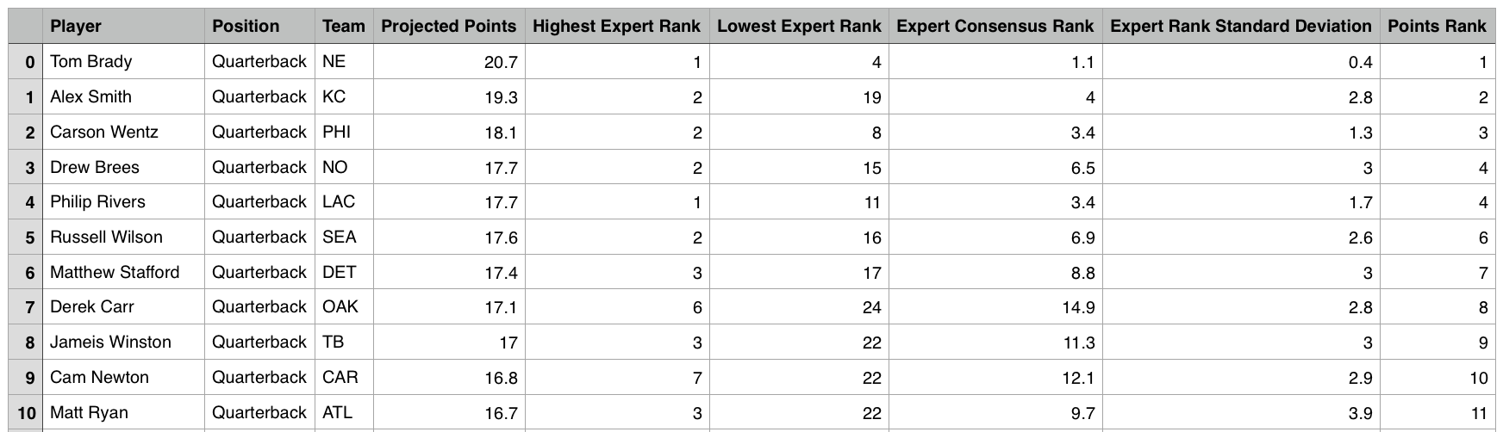
Data
Scrape the aggregate of analyst opinion
Updates weekly to reflect matches
Notes:
Shane
As mentioned earlier, there is an incredible amount of information and one of the advantages of using our visualization is simply the data. There is historic evidence which suggests that the consensus opinion consistently outperform experts. From Fantasy Football to the stock market. In consideration of this, our data is an aggregate of expert projections and rankings. To acquire this data, we previously were using an R script but due to dependency issues we eventually opted to rewrite our script in Python. The resulting data contains player information along with the aggregate of their projected points and rankings which stem from a multitude of analysts sources.

Slide 4
Users
Any participant of Fantasy Football
New Users
Simplifying Football data in comprehensible, familiar terms
Overcome disadvantages due to inexperience --bridge the gap.
Veteran users
Interested in exploring the Fantasy Football data through a different view
Assist in substantiating educated decisions
Notes:
Shane
The users are any Fantasy Football participant –from newbies to veterans. As a result, one of the our visualization should create user experience that is robust enough to appeal to a wide range of skill levels. Firstly, new users with relatively little knowledge of current NFL players can be at a disadvantage when selecting players compared to veteran league members. We want to simplify that information and visualize it in a familiar format to ultimately bridge the gap between new users and veteran users. For veteran players, we want to build a visualization that is fun to interact with, despite their preexisting knowledge, by allowing them to explore the data they’re familiar with through another view and ultimately, assist in substantiating decisions.

Slide 5
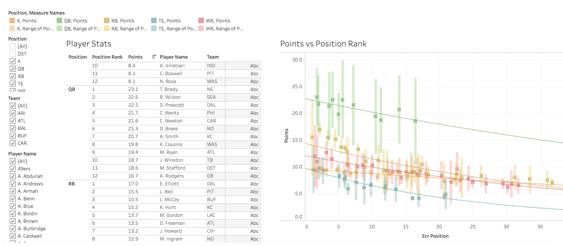
Usability Testing
https://public.tableau.com/profile/michelle.liu7866#!/vizhome/W209_FinalProject_v3/Dashboard1?publish=yes
Notes:
David
This is the version our site that we use for User Testing. I was just the Tableau version but this is where the meat of our site lies and that link is above.

Slide 6
Iterations from user feedback
Cosmetic:
Changed how the players’ names are displayed
Elaborated on the labels in figures
Removed extra column in table
Functional:
Synced up the filters
Included an introduction and also instructions on how to use the visualization
Reduced the amount of noise displayed
Notes:
David
Even the small things can trip someone up using the site. You could look at it as fine tuning but it makes a drastic difference in the user experience.

Slide 7
Insights + Use Cases
Increasing level Skill of User and Insight
Basic Insights
Reading a value
Identifying a player's expected points
Identifying a player's expert consensus ranking (ECR)
Identifying extrema
Identify what player will score the most points for a position.
Identify what player will have the highest ECR for a position
Characterize distribution
Typical projected score of a position ranked within the top ten (ECR)?
Describing correlation
See the trend of projected points as (ECR) increases
Comparative Insights
Comparing values
Compare two players within a position
Difference in ECR between two players
Comparing extrema
Most valuable based on projected points
Most undervalued, in terms of ECR and projected points?
Comparing distribution
Distribution of projected points (or VOR) of two different positions?
Distribution of ECR of two different positions?
Comparing correlation
The position with the highest correlation between expert consensus ranking (ECR) and projected points or VOR?
Increasing level Skill of User and Insight
Notes:
David

Slide 8
Best solution?
Split our visualization into two dashboards
Focus on who to start
Understand the data as is
Add an unique some insight on player value that is recalculated as the field of players is adjusted
Notes:
Michelle
We believe that our visualization to aid with fantasy football is the best solution to accomplish the two primary tasks that Shane mentioned. We opted to split our visualization into two. The first dashboard is intended to focus on what players the user should use to start and to understand the data as is. The second dashboard adds a second dimension to the data and also add some insights on player value that is recalculated as the field of players is adjusted by the user. This “value over replacement” field that we calculated within Tableau is unique and is not readily available to users from just looking at websites such as ESPN.

Slide 9
Viz Techniques Used
Color/Contrast & Opacity
Highlighting
Filters
Barcharts
Trendlines
Notes:
Michelle
To make our visualization tool easy to use, we created a home page for our project using Bootstrap. We included background information about the project, our contact information, the two dashboards, as well as a “How to Use” page. Using Tableau, we are able to take advantage of its many visualization tools to display the information. I will talk about these different techniques used as we go over the demo.

Slide 10
Demo
http://people.ischool.berkeley.edu/~david.jablonski/
Notes:
Michelle

Slide 11
Questions?
Please email any questions and feedback about our project to:
michelleliu103@berkeley.edu
shane.conner@berkeley.edu
david.jablonski@berkeley.edu

